Slide 1

The State of AI
INNOVATIONS, APPLICATIONS, AND IMPACTS IN PLANNING
J. Langley
Founder, Huntsville AI
CTO, CohesionForce, Inc
Josh Phillips
Data Group Working Lead, Open Model Initiative
CDO, CohesionForce, Inc

Slide 2
INTRODUCTION TO HUNTSVILLE AI
Our vision is a group of individuals and organizations in the metro Huntsville area who collaboratively advance the knowledge and application of artificial intelligence in ways that make it available to everyone and improve our quality of life.
https://hsv.ai/subscribe/

Slide 3

How did we get here?
INSANELY FAST HISTORY LESSON
We’re going to move fast through the next 25 slides, so here’s a link to download if you want to circle back later :)

Slide 4
POP QUIZ
What is the first mention in writing of a “Thinking Machine”?
1950
1945
1936
1920
1863

Slide 5
POP QUIZ
What is the first mention in writing of a “Thinking Machine”?
1950 - Computing Machinery and Intelligence”, Alan Turing
1945 - "As We May Think", Vannevar Bush
1936 - “On Computable Numbers, with an Application to the Entscheidungsproblem”, Alan Turing
1920 - “R.U.R”, Karel Capek (Rossum's Universal Robots)
1863 - “Darwin Among the Machines”, Samuel Butler

Slide 6
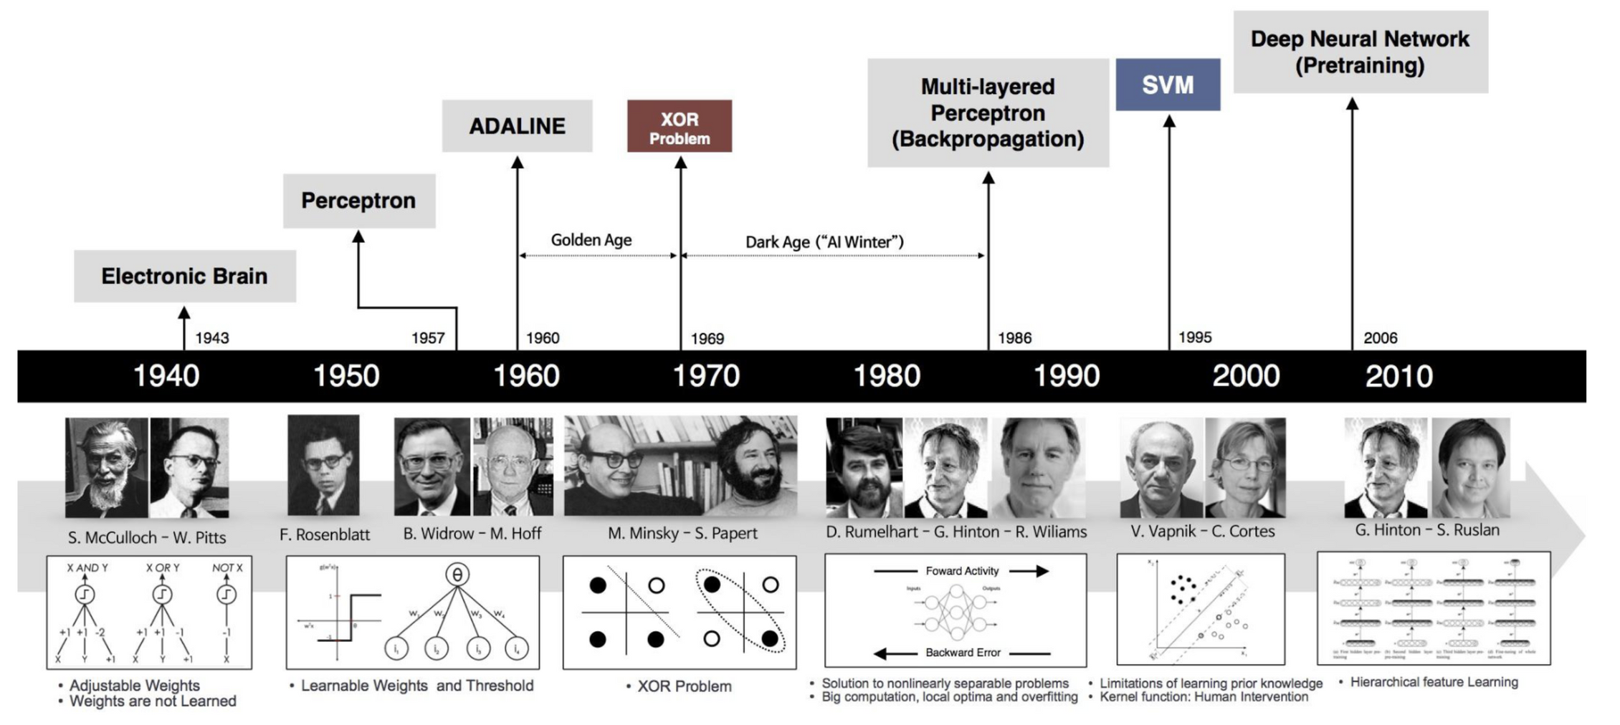

Slide 7
ALAN TURING (1950)
Alan Turing’s "Computing Machinery and Intelligence," published in 1950 in the journal Mind.
The Imitation Game (Turing Test):
Turing proposed the "Imitation Game" (later known as the Turing Test) as a way to operationalize the question, "Can machines think?" The test involves a human evaluator engaging in a text-based conversation with a machine and another human, without knowing which is which. If the evaluator cannot reliably distinguish the machine from the human, the machine is said to exhibit intelligent behavior.
The Turing Test has been a central topic in debates about AI's capabilities and the nature of intelligence.

Slide 8
JOHN MCCARTHY (1956)
The title "Father of Artificial Intelligence" is most commonly attributed to John McCarthy, an American computer scientist. He is credited with coining the term "Artificial Intelligence" in 1956 during the Dartmouth Conference, which is widely regarded as the founding event of AI as a field of study.
We’ll run into Mr McCarthy again in a few slides :)

Slide 9
ROSENBLATT’S PERCEPTRON (1958)
The perceptron algorithm was invented in 1957 at the Cornell Aeronautical Laboratory by Frank Rosenblatt, funded by the United States Office of Naval Research.
The perceptron was intended to be a machine, rather than a program, and while its first implementation was in software for the IBM 704, it was subsequently implemented in custom-built hardware as the "Mark 1 perceptron".
This machine was designed for image recognition: it had an array of 400 photocells, randomly connected to the "neurons". Weights were encoded in potentiometers, and weight updates during learning were performed by electric motors.
https://homepages.math.uic.edu/~lreyzin/papers/rosenblatt58.pdf

Slide 10
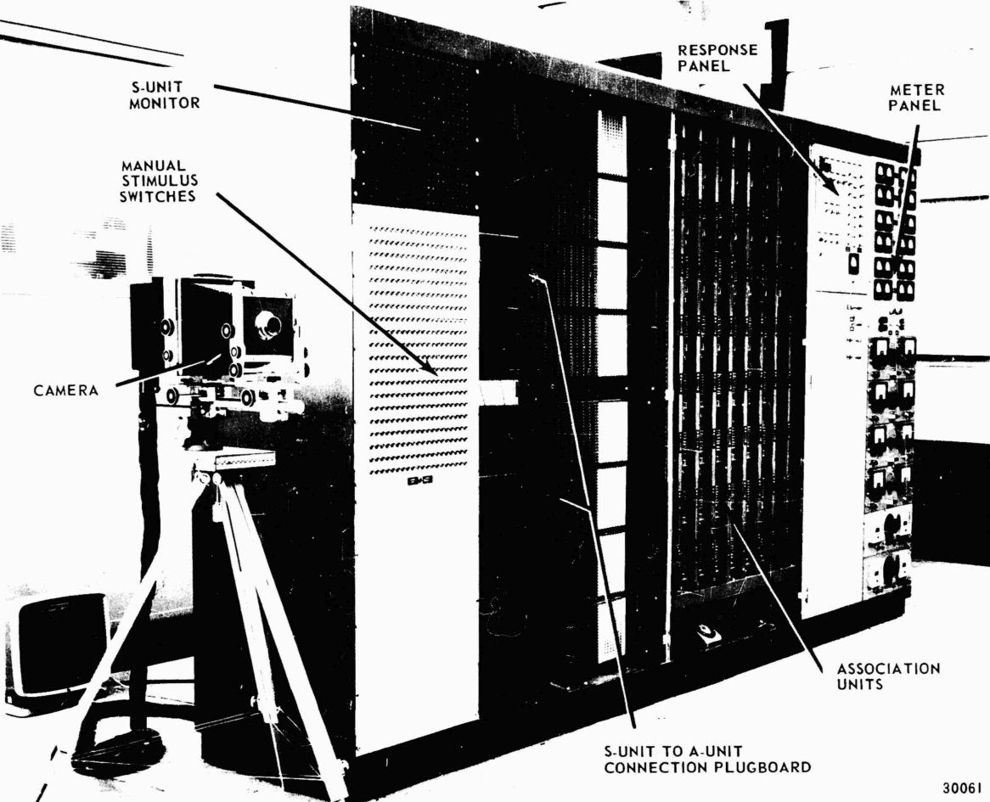
ROSENBLATT’S PERCEPTRON (1958)
It utilized vacuum tubes as well as resistors, capacitors, and other electronic components.
The perceptron was built with 512 adjustable weights, implemented using motorized potentiometers, which allowed the system to "learn" by adjusting these weights based on input-output relationships.

Slide 11
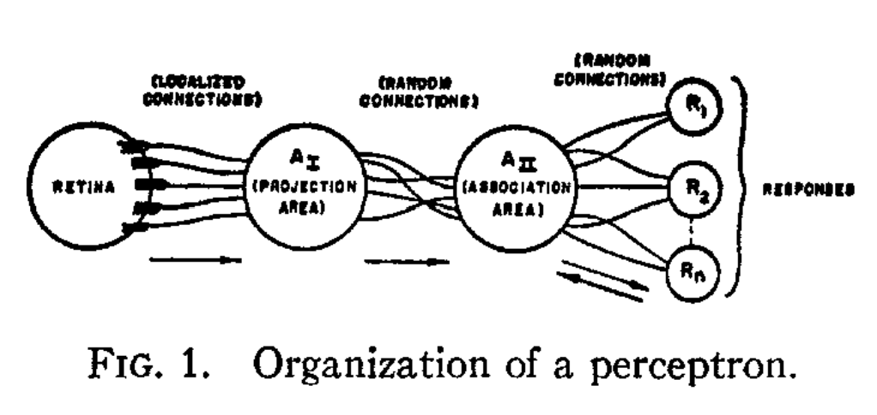
ROSENBLATT’S PERCEPTRON (1958)
The design of the perceptron was based on how the brain was thought to work. This is the first instance of what would later become neural networks.

Slide 12
GOLDEN AGE
General Problem Solver (1959):
Developed by Herbert Simon and Allen Newell, it was designed to solve a wide range of problems by breaking them into smaller sub-problems.
A* Algorithm (1968):
Created by Peter Hart, Nils Nilsson, and Bertram Raphael, A* became a foundational algorithm for pathfinding and graph traversal.
Lisp (1958):
Created by John McCarthy, Lisp became the first programming language specifically designed for AI.
Prolog (1969):
Prolog, developed by Alain Colmerauer and Robert Kowalski, became the foundation for logic programming and expert systems.

Slide 13
GOLDEN AGE
ELIZA (1966):
Developed by Joseph Weizenbaum, ELIZA simulated a Rogerian psychotherapist, marking one of the first successful attempts at conversational AI.
SHRDLU (1968):
Terry Winograd created SHRDLU, which could understand and execute commands in a simulated blocks world, advancing NLP and contextual reasoning.
Automata Theory:
Research into automata and formal languages, led by Noam Chomsky and others, influenced AI by formalizing computational processes.
Logic and Reasoning:
Advancements in formal logic, particularly predicate calculus, became integral to AI's ability to model knowledge and reasoning.

Slide 14
AI WINTER (1969)
Perceptrons: an introduction to computational geometry by Marvin Minsky and Seymour Papert - published in 1969.
It offered a mathematical proof that the perceptron could not approximate an XOR function given an infinite training set.

Slide 15
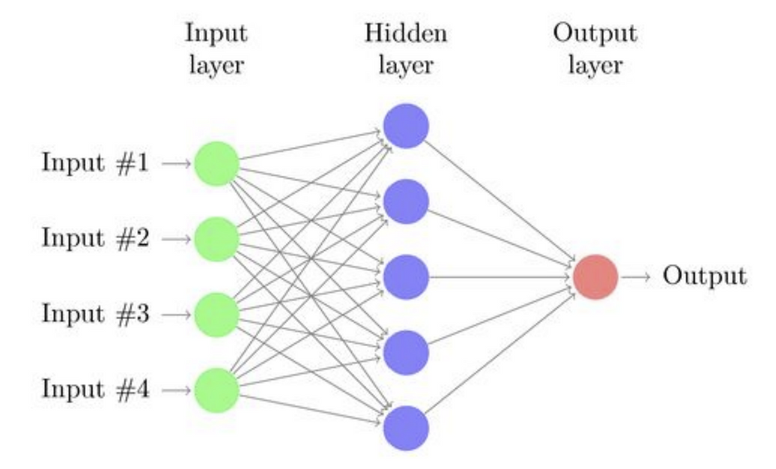
MULTI-LAYER PERCEPTRONS
By stacking several layers of perceptrons, researchers were able to overcome the XOR problem.
But it was nearly impossible to train!

Slide 16
BACKPROPAGATION (1986)
Geoff Hinton, along with David Rumelhart and Ronald Williams, published a paper entitled “Learning representations by back-propagating errors”
Loss is computed at the output based on difference between it and the known answer.
Weights are updated moving backward through the neural network.
Caution - there’s a lot of math here

Slide 17
UNIVERSAL APPROXIMATION THEOREM (1989)
The Universal Approximation Theorem is a fundamental result in the theory of neural networks. It states that a feedforward neural network with at least one hidden layer, a sufficient number of neurons, and a suitable activation function can approximate any continuous function to any desired degree of accuracy, given appropriate weights and biases.
Generally credited to papers by George Cybenko (1989) and Kurt Hornik et al. (1989)

Slide 18
NEURAL NETWORKS
Tensorflow Playground

Slide 19
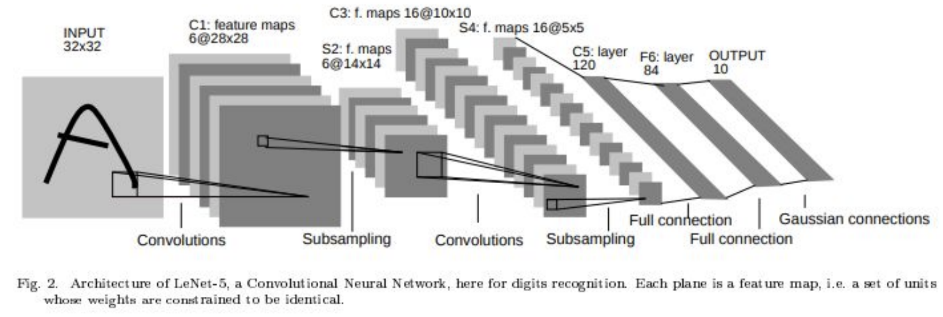
LEARNING BEFORE “DEEP” (1998)
Gradient Based Learning Applied to Document Recognition - Yann Lecun -
CNN from Yann Lecun (AT&T Bell Labs) could recognize handwritten digits.

Slide 20
ROLLING IN THE DEEP (2006)
Deep Learning (2006) - Again with Geoff Hinton. The idea was to train a simple 2-layer unsupervised model like a restricted boltzman machine, freeze all the parameters, stick on a new layer on top and train just the parameters for the new layer. Using this strategy, people were able to train networks that were deeper than previous attempts, prompting a rebranding of ‘neural networks’ to ‘deep learning’.

Slide 21
ACCELERATED BY HARDWARE AND DATA
It takes a lot of data to train a deep neural network:
Imagenet (2009) - millions of labeled images created and published by Fei-Fei Li at Stanford
MNIST (1999) - Handwritten digits
Google House Numbers from street view (2014) - created by an intern at Google (Ian Goodfellow)
Flickr 30k Image dataset (2014)
You also need some good hardware at doing simultaneous calculation:
GPU - used for multi-core floating point calculation

Slide 22
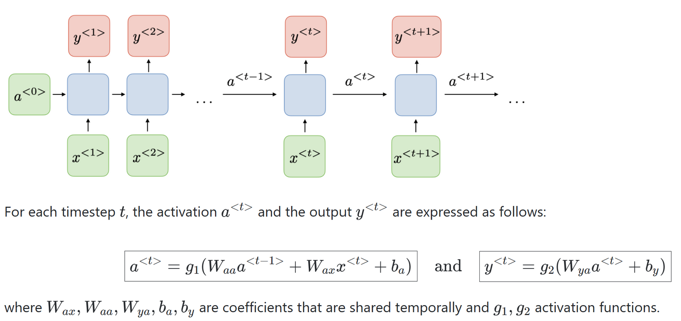
RECURRENT NEURAL NETWORKS (2010 - 2017)
Recurrent neural networks, also known as RNNs, are a class of neural networks that allow previous outputs to be used as inputs while having hidden states. They are typically as follows:
Credit - Stanford

Slide 23
ADVANCEMENTS OF DEEP LEARNING
Major leaps began to happen in the 2010's as the capability of these networks began to reach human level.
Alexnet (2012) - Won the Large Scale Visual Recognition Challenge(LSVRC) with an error rate 10% lower than the previous year. Used dropout to reduce overfitting and a rectified linear activation unit (ReLU)
Generative Adversarial Networks (2014) - Ian Goodfellow -
Gated Recurrent Units (2014) - this is when Siri, Alexa, Google Voice began to actually understand my accent.
“Langley Theory of AI” - they tried something and it somehow worked. Then they had to write a paper to figure out why.

Slide 24
THE TRANSFORMER (2017 - PRESENT)
Introduced by: Vaswani et al. in the paper "Attention is All You Need"
Self-Attention Mechanism: Models relationships between all tokens in a sequence simultaneously, eliminating the need for sequential processing.
Positional Encoding: Adds positional information to input embeddings since Transformers do not process data sequentially.
Feedforward Networks: Applied after the self-attention mechanism within each layer.
Multi-Head Attention: Allows the model to focus on different parts of the input simultaneously.
Parallelism: Processes entire sequences at once, significantly speeding up training compared to RNNs.

Slide 25
THE TRANSFORMER (2017 - PRESENT)
Advantages:
Handles long-range dependencies effectively.
Scales well with increased data and compute.
Allows for parallel processing, leading to faster training.
BERT (2018)
Bidirectional Encoder Representations from Transformers.
Pretrained on massive text corpora using a masked language modeling objective.
Fine-tuned for downstream tasks like sentiment analysis, question answering, and named entity recognition.
GPT (2018–2023+)
Generative Pre-trained Transformer.
Introduced by OpenAI, focused on autoregressive language modeling (predicting the next token).
GPT models (GPT-2, GPT-3, GPT-4) scaled up significantly, achieving remarkable results in text generation.

Slide 26
FINE TUNING
Fine-tuning a large language model (LLM) involves adapting a pretrained model (e.g., GPT, BERT) to perform specific tasks or align its behavior with particular requirements. This process leverages the general knowledge learned during pretraining and refines it using task-specific data.
Fine-tuning can also be applied to other deep learning networks, such as CNNs to be able to classify specific images.

Slide 27
REINFORCEMENT LEARNING WITH HUMAN FEEDBACK (RLHF)
Description:
Combines reinforcement learning with human-labeled data to guide the model's behavior.
Pretraining:
The model is pretrained on a large corpus of data using standard objectives (e.g., predicting the next word).
Fine-tuning:
The model is fine-tuned using human feedback to optimize for specific goals.
Reward Modeling:
Human preferences are collected by showing multiple outputs to humans and asking them to rank the responses.
A reward model is trained on this data to predict the quality of a response.
Policy Optimization:
The model is fine-tuned using reinforcement learning, optimizing for the reward model's scores.

Slide 28
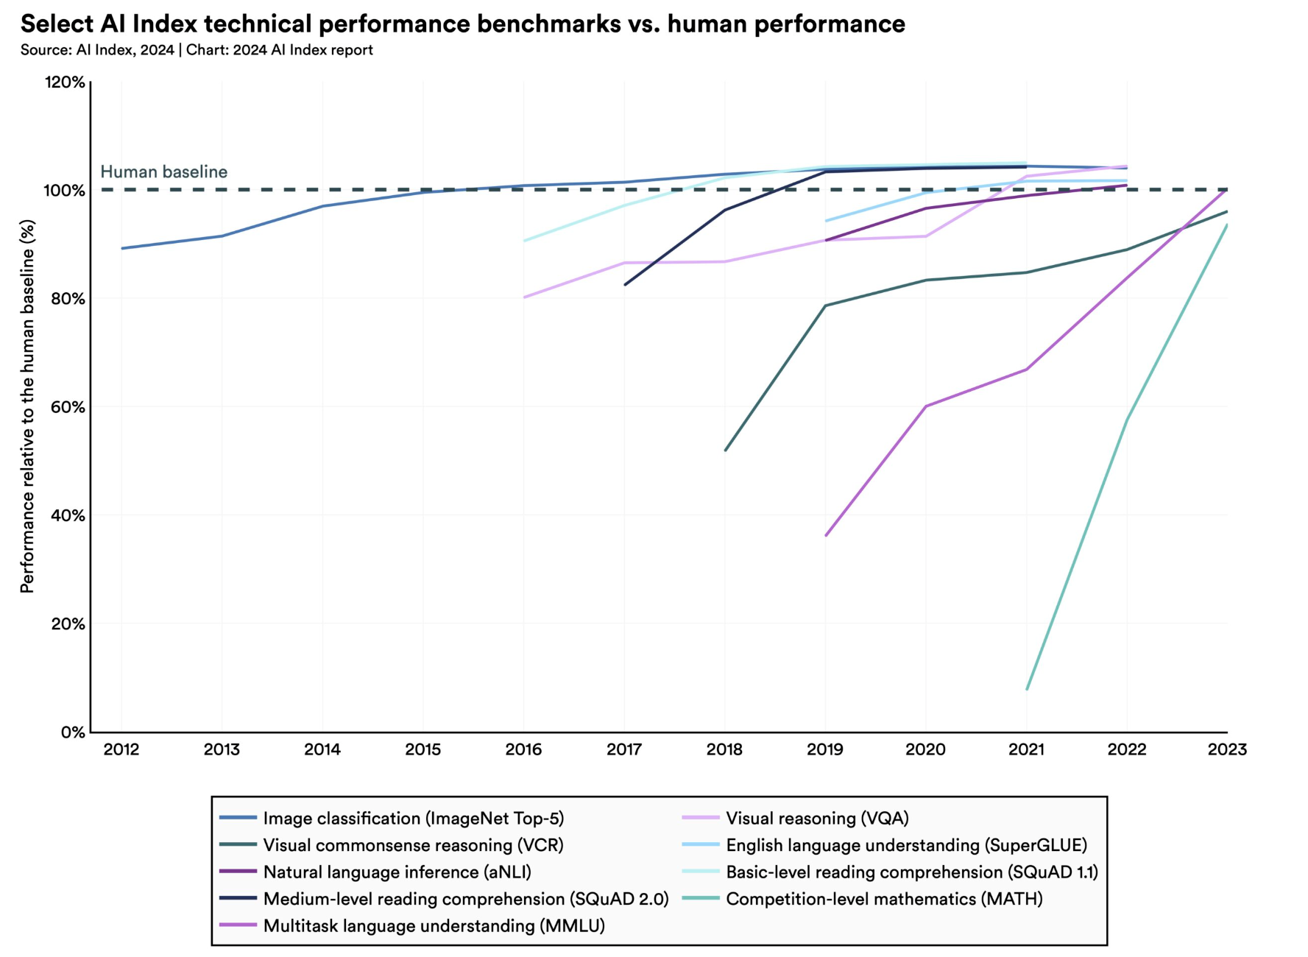
AI AT HUMAN LEVEL

Slide 29
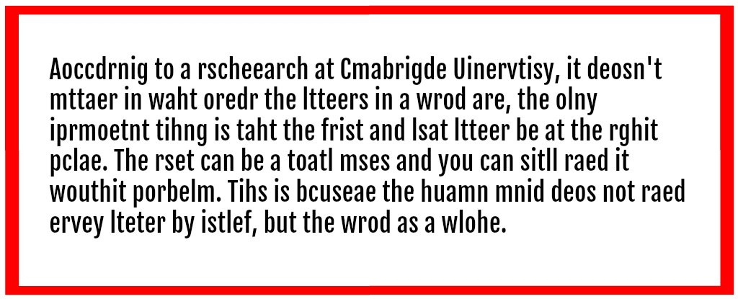
WHAT DOES HUMAN LEVEL MEAN ANYWAY?
Factually incorrect, but fun meme

Slide 30
AI Challenges
for Planning
How are advances and adoption of AI by the community affecting urban planning?
How can the challenges be addressed?

Slide 31
AUTONOMOUS VEHICLES
Ghost Riders
Camera-covered cars with nobody inside are causing traffic jams, angering residents and amazing tourists
Parking
They don’t actually have to park - it’s often cheaper to cruise city streets at low speeds. Or park in front of private houses.
Waymo cars honk at each other throughout the night, disturbing SF neighbors
Driving Behavior
Waymo passenger nearly misses his flight after car drives in circles
‘Complete meltdown’: Driverless cars in San Francisco stall causing a traffic jam
Armed with traffic cones, protesters are immobilizing driverless cars

Slide 32
ROUTING & RECOMENDATION
Nagivation
Your Navigation App Is Making Traffic Unmanageable
Individual rather than Community focused
Automated navigation systems are still wreaking havoc on small towns’ streets
Apps like Google and Waze are redirecting traffic to secondary roads that are not equipped to handle the traffic, disrupting their infrastructure.
Communication
Friction with social media recommendation algorithms
Real Estate Investment
Tons of AI based investment advisers - may not match city planning forecasts
Zillow, Redfin, Mashvisor, Reonomy (Commercial Real Estate)
I lost a lot more time looking at property than I should have

Slide 33
AI Advancements in Planning
What types of things can AI do?
How are advances and adoption of AI by urban planners affecting the community?

Slide 34
AI TECHNIQUES
Natural Language Processing - Classification, Summarization, Generation
Computer Vision - Classification, Segmentation, Enhancement, Generation
Audio Processing - Recognition, Classification, Generation
Multimodal Tasks - Text-to-Image, Text-to-Sound, Text-to-Video
Reinforcement Learning - Autonomous Vehicles, Robotics, Optimization
Recommendation Systems - Collaborative Filtering, Content Based, Implicit
Generative AI - Text, Images, Audio, Video
Agentic AI - Tool Calling, Decision Making
Robotics - Humanoid Robots, Autonomous Drones, Self Driving Cars

Slide 35
NATURAL LANGUAGE PROCESSING
Classification
Named Entity Recognition
Sentiment Analysis
Summarization
Semantic Understanding
Language Translation

Slide 36
NATURAL LANGUAGE PROCESSING
Limitations
Language Bias
Gender Bias
Racial / Ethnic Bias
Detecting sarcasm or dark humor
Words change meaning over time
Implied context
Model context size
Emerging language (generational problems)

Slide 37
COMPUTER VISION
Classification
Segmentation
Enhancement
Object Recognition
Facial Recognition
Pose Recognition

Slide 38
COMPUTER VISION
Limitations
Gender Bias
Racial / Ethnic Bias
Images without context
Difficulty translating to real world implementation
Adversarial vulnerabilities by changing small parts of images
Lack of physical world understanding

Slide 39
MULTIMODAL TASKS
Image-to-Text
Generating descriptive textual captions for a given image.
Answering questions based on the content of an image.
Retrieving the most relevant image given a textual query or vice versa.
Text-to-Image
Generating images based on textual descriptions.
Audio-to-Text
Generating textual descriptions of audio events.
Speech Recognition
Text-to-Audio
Generating speech from textual input.
Generating music from textual input.
Audio/Video-to-Text
Improved speech recognition by combining video and audio

Slide 40
MULTIMODAL TASKS
Limitations
Data Alignment (time alignment), scarcity for some domains, data diversity.
Domain transfer problems (movie subtitles vs instructional videos)
Interpretability or Explainability with troubleshooting problems
Difficult to evaluate correctness - lack of benchmarks and metrics
Imbalanced datasets (more text than audio than video)

Slide 41
GENERATIVE AI
Generating Text - lots and lots of text.
Can be formatted in specific ways
Can match a given tone
Images
Can create images from text descriptions.
Can alter images based on another provided image
Audio
Can create audio from text
Can create music from text
Video
Can create video from text
Short clips are fairly easy at the moment, with longer running videos coming soon

Slide 42
GENERATIVE AI
Technical Limitations
Plagiarism and Copyright Issues - Generated content may inadvertently copy from the training data, raising intellectual property concerns.
Misinformation and Deepfakes - Generative AI can create highly convincing fake text, images, videos, and audio, making it easier to spread misinformation.
Coherence in Long Outputs - Struggles to maintain coherence in long or complex narratives.
Cultural/Ethical Limitations
Alignment to cultural norms
Misuse by bad actors

Slide 43
URBAN AI OCTOBER 2024
2nd ACM SIGSPATIAL International Workshop on Advances in Urban AI
Proceedings are available here: https://urbanai.ornl.gov/urbanai2024/wp-content/uploads/sites/5/2024/11/Urban-AI-2024-proceedings.pdf
Topics:
A Graph Deep Learning Model for Station Ridership Prediction in Expanding Metro Networks
Smart Route: A GIS-Based Solution for Mass Transit Design and Optimization
Generative-AI based Map Representation and Localization
Encryption Techniques for Privacy-Preserving CNN Models Performance and Practicality in Urban AI Applications
SurfaceAI: Automated creation of cohesive road surface quality datasets based on open street-level

Slide 44
AAAI 2025'S WORKSHOP ON AI FOR URBAN PLANNING
The 1st Workshop on AI for Urban Planning aims to bring together researchers, practitioners, and policymakers to explore innovative AI-driven solutions for the multifaceted challenges in urban planning.
Website - https://ai-for-urban-planning.github.io/AAAI25-workshop
Selected Presentations:
Integrating Human Dynamics into AI-Driven GeoDesign for Sustainable Urban Futures
Mining E-scooter Safety Policies and Plans with GPT-4o and Latent Dirichlet Allocation (LDA) Topic Modeling

Slide 45
AAAI 2025'S WORKSHOP ON AI FOR URBAN PLANNING
Integrating Human Dynamics into AI-Driven Urban Science for Symbiotic Futures
Applications of AI:
Image detection of doors viewed from street. Triangulation to estimate elevation of the door. Data used to evaluate risk of flood damage.
Combining multiple data sources like building footprints, LiDAR, property records, and street view images helps overcome individual dataset constraints
Smart Phone APP to provide an effective way to collect the public's’ design demands and ideas - using AR to let the public view a proposed structure in place
Demonstrate a workflow that efficiently generates detailed and visually coherent landscape designs, including natural parks, city plazas, and courtyard gardens

Slide 46
AVAILABLE PRODUCTS
Stanford University InVEST® is a suite of free, open-source software models used to map and value the goods and services from nature that sustain and fulfill human life.
https://naturalcapitalproject.stanford.edu/software/invest
Autodesk Offerings
https://www.autodesk.com/solutions/urban-design-planning
https://www.autodesk.com/eu/campaigns/spacemaker
Simulation of Urban MObility
https://eclipse.dev/sumo/

Slide 47
Questions?
COMMENTS, OR CRIES OF HERESY?
J. Langley
Founder, Huntsville AI
CTO, CohesionForce, Inc
Josh Phillips
Data Group Working Lead, Open Model Initiative
CDO, CohesionForce, Inc

